Slide 1
Lean Software Development
Agile Development Processes
Eric Knauss

Slide 2
Administrative stuff
Errata: Added reference and agile practice map to L4
Guest lecture: Currently being clarified.
May-19 on Large-Scale Agile by Mats and Jimmy (Ericsson)
May-24 on TBD
Meeting with course representatives: Today during break.
Dominik Einkemmer
Kyriakos Malamas
Shahanas Cholayil Mayankutty
Amrita Mukherjee
Tibor Salagvárdi

Slide 3

Sprint 2
Focus on Getting work done
http://www.flickr.com/photos/bnsd/15643117918

Slide 4
Course Objectives
Knowledge and understanding | Skills and ability | Judgement and approach
Compare agile and traditional softw. dev, | Forming a team organically | Explain: people/commun. centric dev.
Relate lean and agile development | Collaborate in small software dev. teams | Apply fact: people drive project success
Contrast different agile methodologies | Interact and show progress continuously | Describe: No single methodology fits all
Use the agile manifest and its accompanying principles | Develop SW using small and frequent iterations | Discuss: methodology needs to adopt to culture
Discuss what is different when leading an agile team | Use test-driven dev. and automated tests
 | Refactor a program/design
 | Be member of agile team
 | Incremental planning using user stories
Sprint 3
Sprint 1
Legend
Addressed
Open
Mainly in project
Focus today
Sprint 2

Slide 5
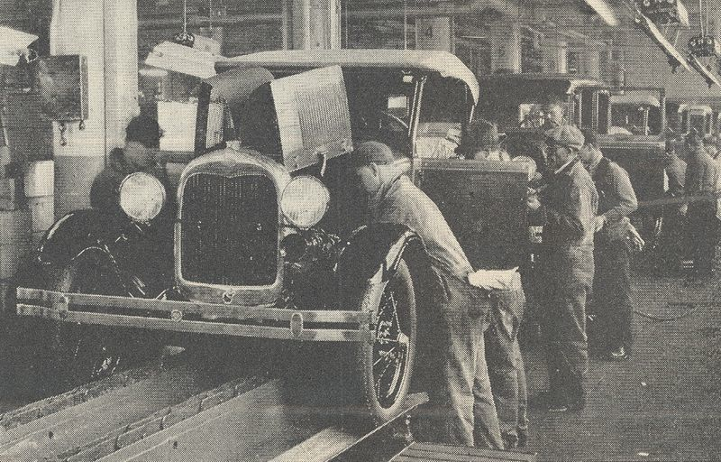
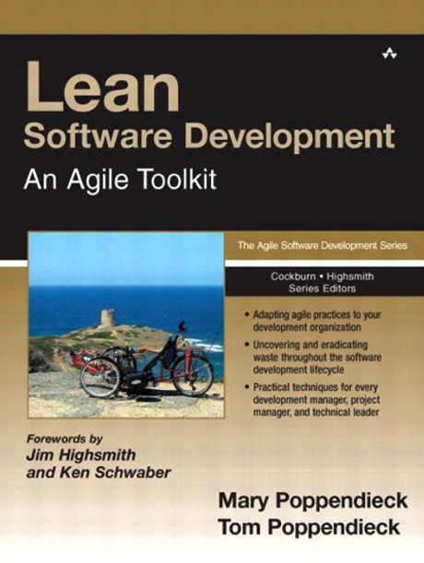
Lean History
Toyota (1980s): "Lean Manufacturing“, revolutionize the automotive industry
eliminate waste
streamline the value chain (even across enterprises)
produce on request (just in time), and
focus on the people who add value.
Mary and Tom Poppendieck: transferred principles and practices from manufacturing to the software development
http://en.wikipedia.org/wiki/Fordism

Slide 6
Software Development as Manufacturing
 | Manufacturing Mass Production | Waterfall Model
Hidden Cost | Transportation Managing inventory and storage Capital costs of inventory | Handoffs Lots of open items; can lead to overwhelming the workforce Cost of training people to build software
Risks | Building things you don’t need because production goes on after needs go away Inventory becoming obsolete Huge latency if an error occurs | Building things you don’t need because requirements aren’t clear or customers change their minds Knowledge degrading quickly If a line is discontinued, all WIP wasted Errors in requirements discovered late in the process Errors in completed code discovered late in testing
Lean-Agile Software Development: Achieving Enterprise Agility, by Alan Shalloway, Guy Beaver, and Jim Trott. Chapter 1.

Slide 7
Lean Mindset
Related to, but not the same as agile mindset!
Most errors are of a systemic nature → Development system must be improved.
You must respect your people in order to improve your system.
Doing things too early causes waste.
Do things just before you need to do them
This is called “Just-In-Time,” or JIT.
Focus on shortening time-to-market by removing delays in the development process
Using JIT methods to do this is more important than keeping everyone busy.
Lean-Agile Software Development: Achieving Enterprise Agility, by Alan Shalloway, Guy Beaver, and Jim Trott. Chapter 1.

Slide 8
LSD: 7 Principles, 22 Tools
Eliminate Waste – Seeing Waste, Value Stream Mapping
Amplify Learning – Feedback, Iterations, Synchronization, Set-Based Development
Decide as Late as Possible – Options Thinking, The Last Responsible Moment, Making Decisions
Deliver as Fast as Possible – Pull Systems, Queuing Theory, Cost of Delay
Empower the Team – Self-Determination, Motivation, Leadership, Expertise
Build Integrity In – Perceived Integrity, Conceptual Integrity, Refactoring, Testing
See the Whole – Measurements, Contracts
Cristoph Steindl (IBM), Lean Software Development, 2004 (Presentation)

Slide 9
Principle #1: Eliminate Waste
... does not mean to throw away all documentation
spend time only on what adds real customer value.
Eliminating waste is the most fundamental lean principle.
First step to implementing lean development: learning to see waste.
Second step: uncover biggest sources of waste and eliminate them.
Uncover Waste
Eliminate Waste
Cristoph Steindl (IBM), Lean Software Development, 2004 (Presentation)

Slide 10
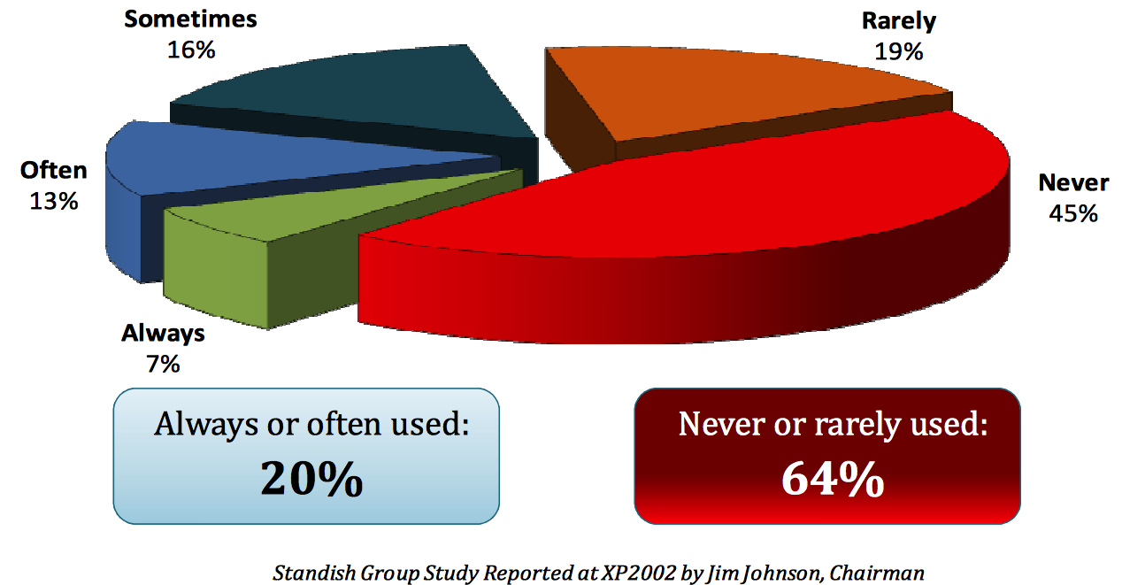
Rates of Feature Usage in Software Projects

Slide 11
#1: Eliminating Waste Tool #1: Seeing Waste
Inventory
Partially done work
Extra processing
Paperwork
Over production
Unused features
Transportation
Task switching
Waiting
For staffing,
For approval,
For review,
For exessive requirements,
For testing,
For deployment
Motion
Handovers, finding answers for questions
Defects
Waste produced by defect = impact x time
Cristoph Steindl (IBM), Lean Software Development, 2004 (Presentation)

Slide 12
#1: Eliminating Waste Tool #2: Value Stream Mapping
Pretend you are a customer request
Imagine yourself going through each step of your process
Don’t ask people; walk around, look at data, find out yourself.
Go to the start (where a customer request comes into your organization)
Draw a chart (average customer request, from arrival to completion)
Work with people involved in each activity
Sketch all process steps necessary to handle request,
Capture average amount of time it spends in each step.
Draw Timeline (at the bottom of the map), showing how much time
Request spends in value-adding activities.
Request spends waiting or in non-value adding activities.
Cristoph Steindl (IBM), Lean Software Development, 2004 (Presentation)

Slide 13
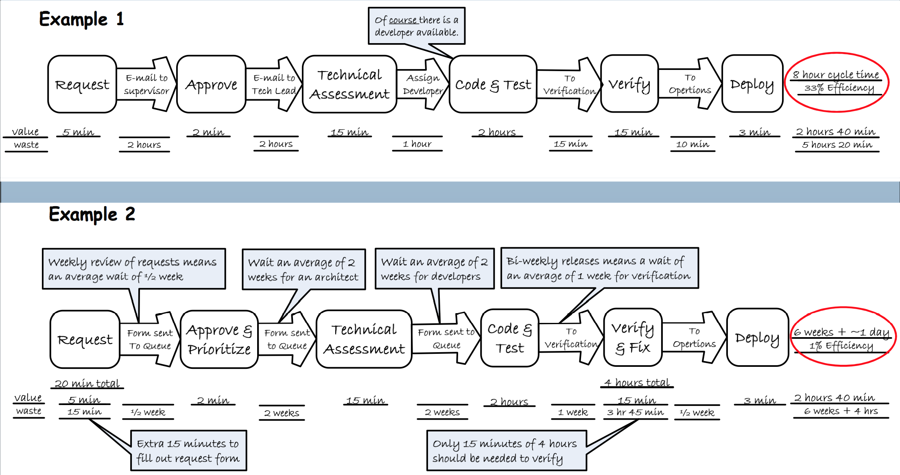
Examples: Value-Stream Mapping
Mary & Tom Poppendieck: Lean Software Development Workshop 2008

Slide 14
Examples: Value-Stream Mapping
Mary & Tom Poppendieck: Lean Software Development Workshop 2008

Slide 15
Group work
?
With your neighbors and about your agile projects:
Discuss waste and value
Discuss the value-stream (e.g. how long does it take to get Terese’s or Magnus’ requests during acceptance tests on their or on my phone?)

Slide 16
#Principle 2: Amplify Learning
Imagine a company with SW development challenges
Usual reaction: Increase discipline / control
Specify requirements more completely
All agreements with customer are written
Changes are controlled more carefully
More tracing
…
As control theory predicts, this generally makes a bad situation worse
Cristoph Steindl (IBM), Lean Software Development, 2004 (Presentation)

Slide 17
#2: Amplify Learning Tool #3: Feedback
If a problem develops:
Make sure that all feedback loops are in place
Increase the frequency of feedback loops in problem areas
Instead of… | …focus on
Gather more requirements | Discuss UI prototypes
Accumulate defects | Test as soon as code is written
More documentation and detailed planning | Check out ideas by writing code
Study carefully which tool to use | Bring top 3 candidates in house and test them
Cristoph Steindl (IBM), Lean Software Development, 2004 (Presentation)

Slide 18
#2: Amplify Learning Tool #3: Feedback
If a problem develops:
Make sure that all feedback loops are in place
Increase the frequency of feedback loops in problem areas
Instead of… | …focus on
Gather more requirements | Discuss UI prototypes
Accumulate defects | Test as soon as code is written
More documentation and detailed planning | Check out ideas by writing code
Study carefully which tool to use | Bring top 3 candidates in house and test them
Cristoph Steindl (IBM), Lean Software Development, 2004 (Presentation)

Slide 19
#2: Amplify Learning Tool #4: Short iterations
Short iterations
Increase control
Help synchronizing developers and customer
Force decisions to be made
------------------------------------------------------------------------
Waterfall Process
Increment 1
Increment 2
Increment 3
Cristoph Steindl (IBM), Lean Software Development, 2004 (Presentation)

Slide 20
#2: Amplify Learning Tool #4: Short iterations
Short iterations
Increase control
Help synchronizing developers and customer
Force decisions to be made
------------------------------------------------------------------------
X
Increment 1
Increment 2
Increment 3
X
Cristoph Steindl (IBM), Lean Software Development, 2004 (Presentation)

Slide 21
#2: Amplify Learning Tool #5: Synchronisation
Sync individuals that work on the same thing
Fundamental for every complex development process
Daily within the team
Daily Scrum
Daily Build
Daily System Test
Weekly within several teams
Push to master at least weekly
Weekly meetings (e.g. Scrum-of-Scrum)
Cristoph Steindl (IBM), Lean Software Development, 2004 (Presentation)

Slide 22
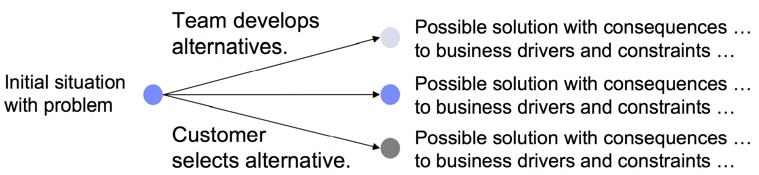
#2: Amplify Learning Tool #6: Set based development
Communicate about constraints, not choices
Use less data to convey more information
Defer making choices until they have to be made
Cristoph Steindl (IBM), Lean Software Development, 2004 (Presentation)

Slide 23
Principle #3: Decide as late as possible
…does not mean to procrastinate,
but to keep your options open as long as practical,
but no longer
Reason
Most common problem: Drill down to details too fast
In the presence of the risk to make big mistakes: survey the landscape and delay detailed decisions
Wait: Is that not equal to sequential development (analyze requirements up-front)?
Sequential development implies depth-first
Breadth-first is far better to manage risk!
Cristoph Steindl (IBM), Lean Software Development, 2004 (Presentation)

Slide 24
#3: Decide as late as possible Tool #7: Options Thinking
Common sense:
Resist making irrevocable decisions under uncertainty
Options allow fact-based decisions (based on learning, not speculation)
E.g. premature design commitment restricts learning, limits usefulness of the product, and increases the cost of change
Plans and predictions are not bad, but avoid making irrevocable decisions based on speculation
Develop options, communicate them and decide together with the customer.
But: options are not free and it takes expertise to know which options to keep open.
Cristoph Steindl (IBM), Lean Software Development, 2004 (Presentation)

Slide 25
Example in Automotive Ecosystem
Decisions
- Make or Buy
- HW or SW
Integration
- Non-functional verification / fixing
Uncertainty
later
earlier
Allow
iterative
development
“Cone of Uncertainty”
B. Boehm. Software Engineering Economics. Prentice-Hall, 1981.
Eric Knauss and Daniela Damian. Towards Enabling Cross-Organizational Modeling in Automotive Ecosystems. In Proceedings of 1st International Workshop on Model-Driven Development Processes and Practices (MD2P2 ’14), Valencia, Spain, 2014.

Slide 26
#3: Decide as late as possible Tool #8: The Last Responsible Moment
Last responsible moment = the moment at which failing to make a decision eliminates an important alternative
Concurrent development allows you to wait for that moment
Share partially complete work
Avoid increasing length of the feedback loop and forcing irreversible decisions to be made sooner than necessary
Good work is a discovery process, done through short, repeated exploratory cycles.
Develop a sense of
how to absorb changes
what is critically important in the domain
when decisions must be made
Cristoph Steindl (IBM), Lean Software Development, 2004 (Presentation)
Notes:
Develop a sense of how to absorb changes (use components with interfaces, use abstraction, avoid repetition, separate concerns, encapsulate variation, avoid extra features).

Slide 27
#3: Decide as late as possible Tool #9: Making decisions
Intuitive decision making is more mature than rational decision making
Usually leads to better decisions
Rational decision making
Decompose problem, remove context, apply analytical techniques, and discuss process and results
Suffers from tunnel vision, intentionally ignoring the instincts of experienced people.
Unlikely to detect high-stakes mistakes.
Developing people with skill to make wise decision beats developing decision-making processes that think for people
Cristoph Steindl (IBM), Lean Software Development, 2004 (Presentation)
Notes:
Let me give you an example from a different area:
Marines plan, but they don't predict.
– They focus on understanding the essence of the situation and the strengths and weaknesses of both sides.
– They find simplifying assumptions, boundary conditions, and alternative approaches.
– They settle on an approach with a 70% chance of success.
– They search for what is being overlooked; they invite dissent.
Marines manage by end state and intent. They tell people what needs to be accomplished and why, and leave the details to them.
They learn to balance discipline and creativity, empowerment and hierarchy, plans and improvisation, rapid action and careful analysis.

Slide 28
Principle #3: Decide as late as possible
Options Thinking, Last Responsible Moment, Making Decisions
Depth- First
Breadth-First
Cristoph Steindl (IBM), Lean Software Development, 2004 (Presentation)

Slide 29
Principle #3: Decide as late as possible
Options Thinking, Last Responsible Moment, Making Decisions
t0
t1
t2
t3
Cristoph Steindl (IBM), Lean Software Development, 2004 (Presentation)

Slide 30
Principle #4: Deliver as fast as possible
…does not mean to rush and do sloppy work, but to deliver value to customers as soon as they ask for it
Customers like rapid delivery
Often translates to increased business flexibility
Deliver faster than their customers can change their minds
Fewer resources tied up in work-in progress.
Deliver as Fast as Possible complements Decide as Late as Possible
The faster you can deliver, the longer you can delay decisions
E.g. if you can make a software change in a week, then you do not have to decide exactly what you are going to do until a week before the change is needed.
Allows to keep options open until uncertainty is reduced, which leads to more informed, fact-based decisions.
Cristoph Steindl (IBM), Lean Software Development, 2004 (Presentation)

Slide 31
#4: Deliver as fast as possible Tool #10: Pull-System
Fundamental: Every team member knows what to do to make the most effective contribution to business
Option 1: tell them what to do (“command & control”)
Option 2: set things up so they can figure it out for themselves (“self-organization”).
In a fast-moving environment, only the second option works
Information radiators / feedback devices:
One of the features of a pull system is visual control, or management by sight.
Everyone must be able to see what is going on, what needs to be done, what problems exist, what progress is being made.

Slide 32
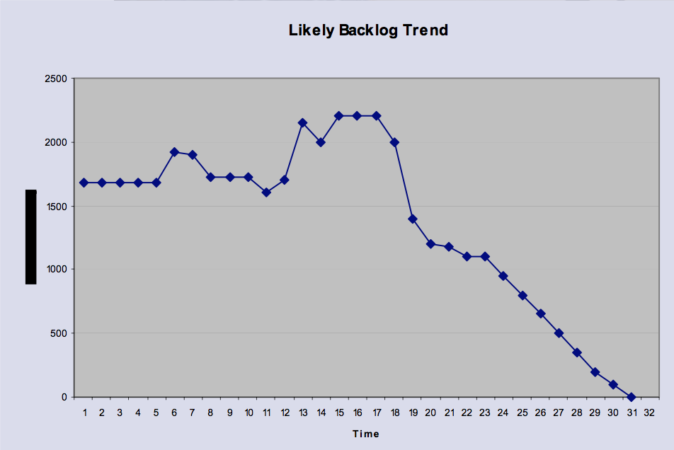
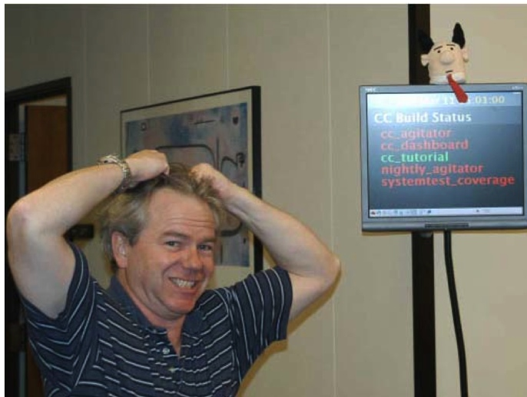
#4: Deliver as fast as possible Tool #10: Pull-System
Fundamental: Every team member knows what to do to make the most effective contribution to business
Option 1: tell them what to do (“command & control”)
Option 2: set things up so they can figure it out for themselves (“self-organization”).
In a fast-moving environment, only the second option works
Information radiators / feedback devices:
One of the features of a pull system is visual control, or management by sight.
Everyone must be able to see what is going on, what needs to be done, what problems exist, what progress is being made.
http://www.developertesting.com/archives/200404/ XtremeFeedbackForSoftwareDevelopment.html

Slide 33
#4: Deliver as fast as possible Tool #11: Queuing Theory
Cycle time
The fundamental measurement of a queue
When you are in a queue, you always want cycle time to be as short as possible.
Steady rate of arrival
Steady rate of service:
Slack

Slide 34
#4: Deliver as fast as possible Tool #11: Queuing Theory
Cycle time
Steady rate of arrival
When arrival of demand is spread out to match the capacity of the system, queues, and therefore cycle times, will be shortened
One way to control the rate of work arrival is to release small packages of work.
Steady rate of service
Slack

Slide 35
#4: Deliver as fast as possible Tool #11: Queuing Theory
Cycle time
Steady rate of arrival
Steady rate of service
The easiest way to remove variability in the processing time is to increase the number of servers that process work in a single queue.
Small work packages will allow parallel processing of the small jobs by multiple teams so that if one is stalled by a problem, the rest of the project can proceed without delay.
Slack

Slide 36
#4: Deliver as fast as possible Tool #11: Queuing Theory
Cycle time
Steady rate of arrival
Steady rate of service
Slack
Short cycle times are not possible if resources are overloaded.
Full utilization provides no value to the overall value stream; in fact, it usually does more harm than good.

Slide 37
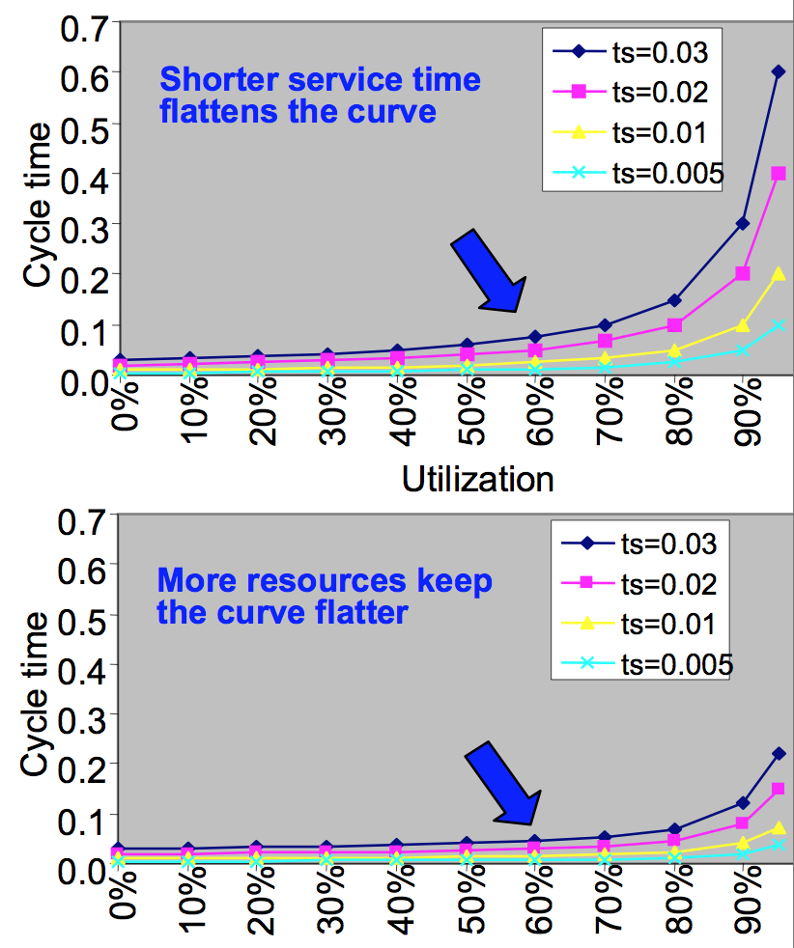
#4: Deliver as fast as possible Tool #11: Queuing Theory
Cycle time
Steady rate of arrival
Steady rate of service
Slack

Slide 38
How Queues work
To increase throughput: look for the current bottleneck that is slowing things down and fix it
Do not increase the utilization of non-bottleneck areas. Don’t keep piling up work that can’t be used immediately.
As variability (in arrival time or processing time) increases, cycle time will increase.
As batch size increases, variability in arrival and processing time increases, and therefore cycle time will increase.
As utilization increases, cycle time will increase nonlinearly.
Continuous flow requires a reduction in variability.
Variability may be reduced by an even arrival of demand, small batches, an even rate of processing, and parallel processing.
Decreasing variability early in the process has larger impact than decreasing variability late in the process.

Slide 39
Group work
?
With your neighbors and about your agile projects:
How can you apply queuing theory in your projects?

Slide 40
#4: Deliver as fast as possible Tool #12: Cost of delay
Create a simple economic model (get good estimates from Marketing)
Show how differences in revenue and market share affect profits
If delay means
“loss of early high pricing” or
“long-term loss of market share”,
cost of delay can be very high
Keep the model simple
Make sure everyone understands and buys into the economic model
Economic models may help to
Justify cost of reducing cycle time, eliminating bottlenecks, and purchasing tools that increase speed
Drive development decisions
Empower the team

Slide 41
Principle #5: Empower the team
…does not mean to abandon leadership, but to let the people who add value use their full potential.
Lean thinking = believing that frontline workers should determine and continually improve the way they do their jobs.
Discipline is important, but experimentation and feedback are more effective than trying to getting things right the first time.
Empowerment is a critical motivating factor:
Move decisions to the lowest possible level in an organization while developing the capacity of those people to make decisions wisely.
In a lean organization, people who add value are the center of organizational energy.
Frontline workers have process design authority and decision-making responsibility; they are the focus of resources, information and training.
Cristoph Steindl (IBM), Lean Software Development, 2004 (Presentation)

Slide 42
Principle #5: Empower the team
…does not mean to abandon leadership, but to let the people who add value use their full potential.
Lean thinking = believing that frontline workers should determine and continually improve the way they do their jobs.
Discipline is important, but experimentation and feedback are more effective than trying to getting things right the first time.
Empowerment is a critical motivating factor:
Move decisions to the lowest possible level in an organization while developing the capacity of those people to make decisions wisely.
In a lean organization, people who add value are the center of organizational energy.
Frontline workers have process design authority and decision-making responsibility; they are the focus of resources, information and training.
Cristoph Steindl (IBM), Lean Software Development, 2004 (Presentation)

Slide 43

Principle #5: Empower the team
Tool #13: Self-Determination
”Here comes Edward Bear now, down the stairs behind Christopher Robin. Bump! Bump! Bump! on the back of his head. It is, as far as he knows, the only way of coming down stairs. He is sure that there must be a better way, if only he could stop bumping for a moment to think of it.”
^{Winnie -The Pooh}
^{A.A. Milne, 1926}
Cristoph Steindl (IBM), Lean Software Development, 2004 (Presentation)

Slide 44
Principle #5: Empower the team
Tool #13: Self-Determination
Tool #14: Motivation
Vision statements from William McKnight (leader of 3M from 1930s through the 1950s):
“Hire good people, and leave them alone.”
“If you put fences around people, you get sheep. Give people the room they need.”
“Encourage, don't itpick. Let people run with an idea.”
“Give it a try – and quick!”
Tool #15: Leadership
Not management!
Cristoph Steindl (IBM), Lean Software Development, 2004 (Presentation)

Slide 45
Principle #5: Empower the team
Tool #13: Self-Determination
Tool #14: Motivation
Tool #15: Leadership
Not management!
Managers | Leaders
Cope with Complexity Plan and Budget Organize and Staff Track and Control | Cope with Change Set Direction Align People Enable Motivation
Cristoph Steindl (IBM), Lean Software Development, 2004 (Presentation)

Slide 46
Principle #5: Empower the team
Tool #13: Self-Determination
Tool #14: Motivation
Tool #15: Leadership
Tool #16: Expertise
Cristoph Steindl (IBM), Lean Software Development, 2004 (Presentation)

Slide 47
Principle #6: Build Integrity in
…does not mean big, upfront design, but don't try to tack on integrity after the fact, build it in.
Kim Clark (Harvard Business School): some companies consistently develop superior products.
Key differentiator: the products had integrity.
External (perceived) integrity: the totality of the product achieves a balance of function, usability, reliability, and economy that delights customers.
Internal (conceptual) integrity: the system’s central concepts work together as a smooth, cohesive whole.
The measure of perceived integrity is roughly equivalent to market share
Conceptual integrity is a prerequisite for perceived integrity
The way to build a system with high perceived and conceptual integrity is to have excellent information flows both from customer to development team and between the upstream and downstream processes of the development team.
Cristoph Steindl (IBM), Lean Software Development, 2004 (Presentation)

Slide 48
Principle #6: Build integrity in Tool #17: Perceived integrity
“Companies that consistently achieve perceived integrity have a way of constantly keeping customer values in front of the technical people making detailed design decisions. Chief engineers have added to their engineering and leadership skills the ability to understand the target customer base and create a vision.”
“Customers will know a good design when they see it, but they can't envision it beforehand. To make matters worse, as their circumstances change, so will customers' perception of system integrity. “
Cristoph Steindl (IBM), Lean Software Development, 2004 (Presentation)

Slide 49
Principle #6: Build integrity in Tool #18: Conceptual integrity
Use integrated problem solving to assure excellent technical information flow
Understanding the problem and solving the problem at the same time, not sequentially.
Preliminary information is released early; information flow is not delayed until complete information is available.
Information is transmitted frequently in small batches, not all at once in a large batch.
Information flows in two directions, not just one.
The preferred media for transmitting information is face-to-face communication as opposed to documents.
Cristoph Steindl (IBM), Lean Software Development, 2004 (Presentation)

Slide 50
Principle #6: Build integrity in Tool #19: Refactoring Tool #20: Testing
If there is not enough time, move resources from writing requirements to writing customer tests
Cristoph Steindl (IBM), Lean Software Development, 2004 (Presentation)

Slide 51
Principle #7: See the Whole
This area | Must attend this work
Business | Continuously prioritize and decompose incremental needs across the organization Manage a portfolio of business needs Do release planning
Management | Organize cross-functional teams that can deliver incremental, end- to-end features Manage the value stream Bring visibility to impediments
Delivery team | Work together, every day, and deliver fully tested and integrated code Learn how to deliver business needs incrementally Become proficient at acceptance test-driven development and refactoring
Lean-Agile Software Development: Achieving Enterprise Agility, by Alan Shalloway, Guy Beaver, and Jim Trott. Chapter 1.

Slide 52
Principle #7: See the whole Tool #21: Measurement
Avoid local sub-optimization
Try to give the whole picture
Do not measure individual performance, but give information
Make clear how measurements relate to business goals
Cristoph Steindl (IBM), Lean Software Development, 2004 (Presentation)

Slide 53

Principle #7: See the whole Tool #21: Measurement

Slide 54
Principle #7: See the whole Tool #22: Contracts
Remember: up to 45% of the features delivered might never be used (according to a study of the Standish Group).
Barry Boehm and Philip Papaccio (1988): the best way to develop low-cost, high-quality software is to write less code.
Rigid control of scope tends to expand, not reduce, the scope. Save money overall by collaborating with the customer by using some form of optional scope contract.
time
quality
costs
scope
Cristoph Steindl (IBM), Lean Software Development, 2004 (Presentation)

Slide 55
LSD: 7 Principles, 22 Tools
Eliminate Waste – Seeing Waste, Value Stream Mapping
Amplify Learning – Feedback, Iterations, Synchronization, Set-Based Development
Decide as Late as Possible – Options Thinking, The Last Responsible Moment, Making Decisions
Deliver as Fast as Possible – Pull Systems, Queuing Theory, Cost of Delay
Empower the Team – Self-Determination, Motivation, Leadership, Expertise
Build Integrity In – Perceived Integrity, Conceptual Integrity, Refactoring, Testing
See the Whole – Measurements, Contracts
Cristoph Steindl (IBM), Lean Software Development, 2004 (Presentation)
Notes:
Repetition

Slide 56
Group work
?
With your neighbors:
Give an example of a software development scenario that is suitable for lean software development and one example that is more suitable for agile software development (e.g. XP or Scrum).
Discuss similarities and differences between agile software development and lean software development.

Slide 57
Agile vs. Lean
Agile tends to emphasize communication at the local level
Lean advocates a holistic view of the delivery chain
XP: Decide now, change later
Lean: Defer commitment
Learning goal today:
Relate lean and agile
Contrast different agile methodologies
Agile has to do a lot with culture and spirit
Lean-Agile Software Development: Achieving Enterprise Agility, by Alan Shalloway, Guy Beaver, and Jim Trott. Chapter 1.

Slide 58
Further reading
Yasuhiro Monden (1998), Toyota Production System, An Integrated Approach to Just-In-Time, Third edition, Norcross, GA: Engineering & Management Press
Mary Poppendieck, Tom Poppendieck (2003), "Lean Software Development: An Agile Toolkit", Addison-Wesley Professional

Slide 59
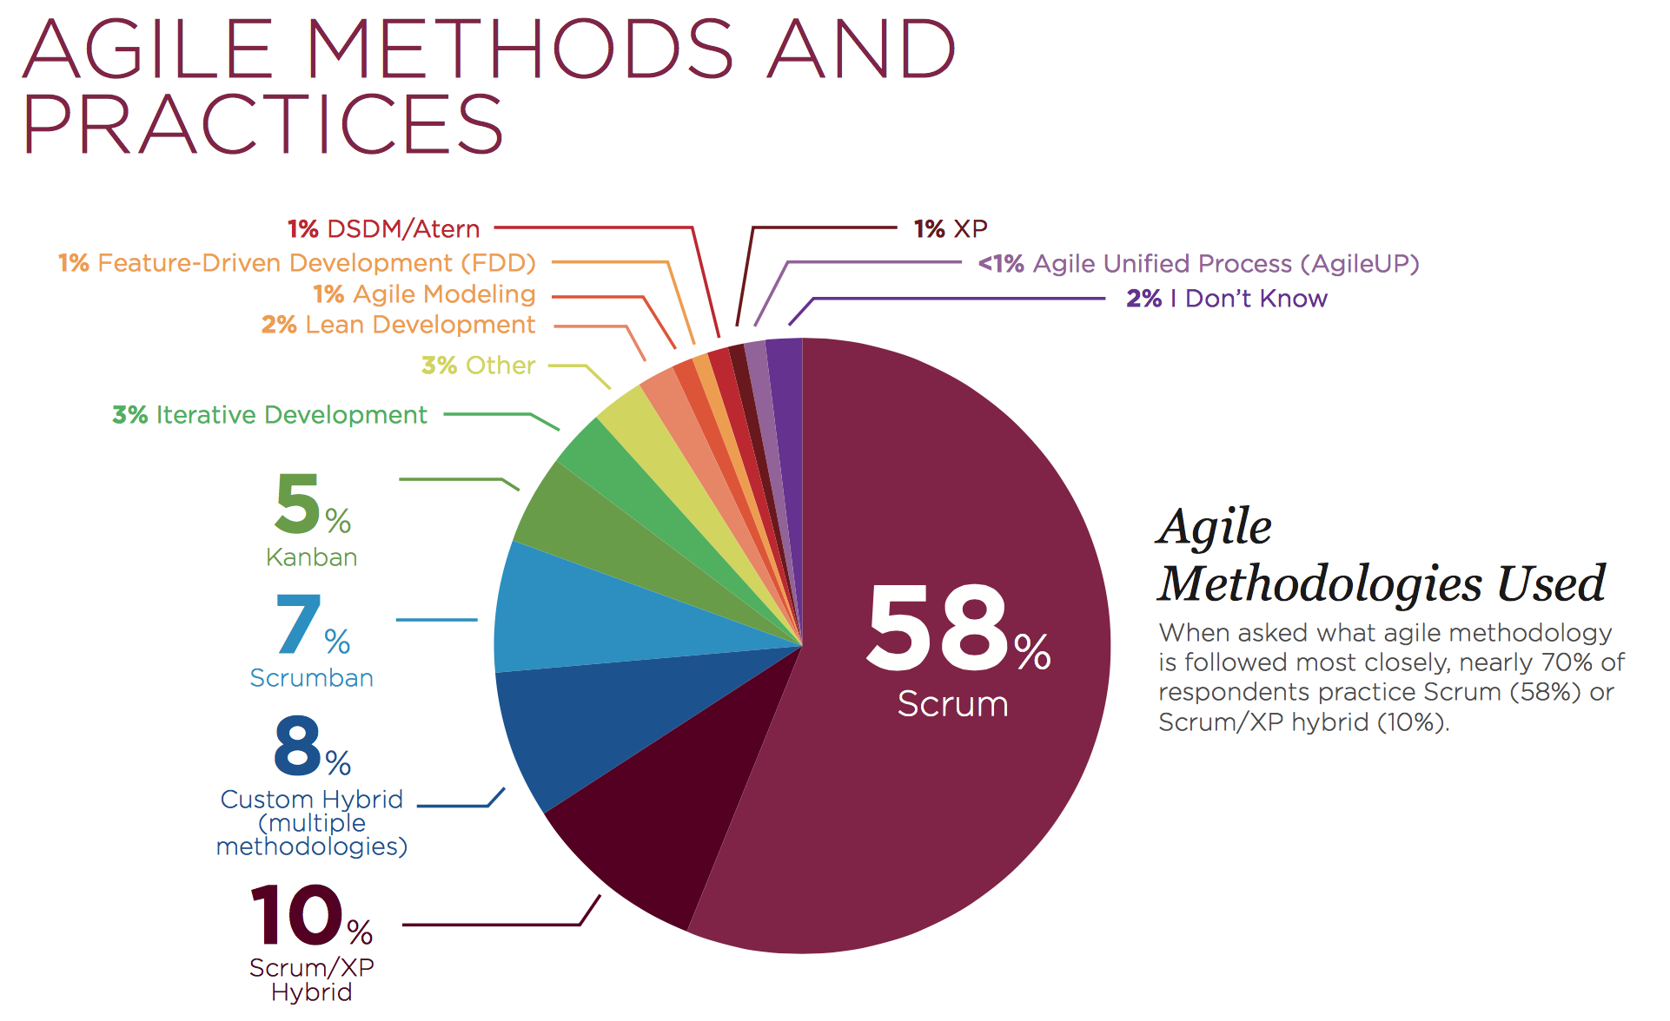
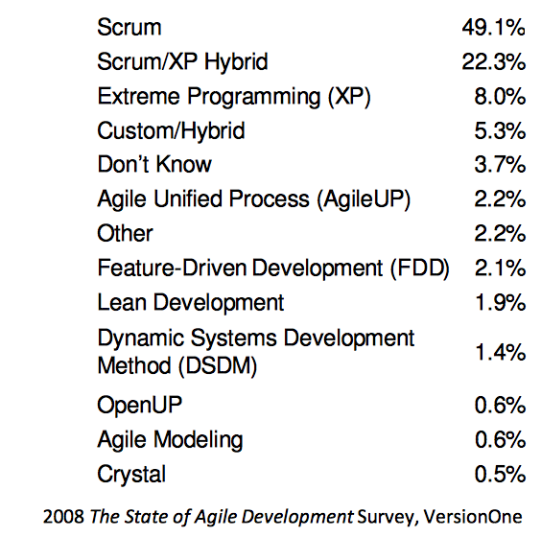
2015 – VersionOne
http://info.versionone.com/state-of-agile-report-thank-you.html

